Slide 1
Scaling and Encoding
Scaling: Converting numeric features to a common scale
Example: Age and income
Encoding: Converting categorical variables to a numerical scale
Example: Gender values of Male and Female

Slide 2
Working With Numeric Features – Scaling
Scaling: Putting all the features on the same ruler/scale
Ensures that features on vastly different scales (e.g. age and income) do not overshadow each other
Scaling methods:
Standardization: Subtracts the mean and divides by the standard deviation
Normalization: Scales to a specific range like 0-1 or -1 to 1
Min-max scaling: Scales to a specific range based on the minimum and maximum values

Slide 3
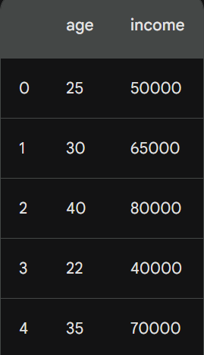
Standardization Scaling Example
Consider enclosed data
Step 1: Calculate mean and SD for each column:
age_mean = (25 + 30 + 40 + 22 + 35) / 5 = 30.4
age_std = sqrt(((25-30.4)^2 + (30-30.4)^2 + ... + (35-30.4)^2) / 5) = 5.48
income_mean = (50000 + 65000 + 80000 + 40000 + 70000) / 5 = 61000
income_std = sqrt(((50000-61000)^2 + (65000-61000)^2 + ... + (70000-61000)^2) / 5) = 13416.43

Slide 4
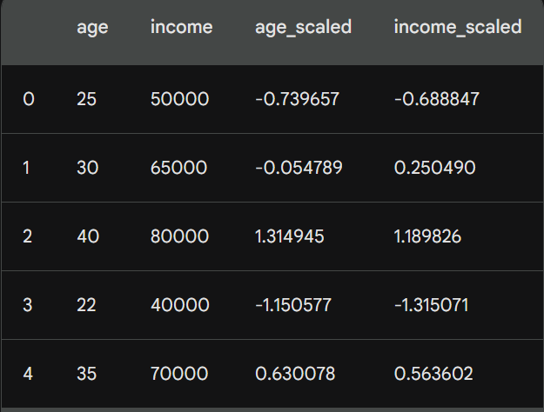
Standardization Scaling Example
Step 2: Standardize each column:
age_scaled = (age - age_mean) / age_std
income_scaled = (income - income_mean) / income_std
Step 3: Write Scaled data:

Slide 5
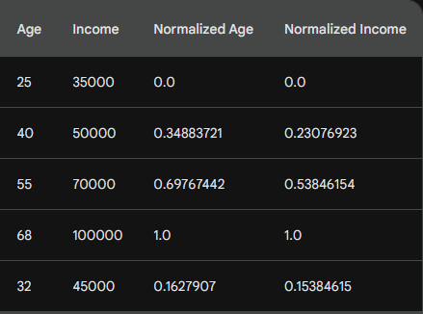
Normalized Scaling for a Similar Example
How are they calculated?
Normalized Age: This column shows the original age minus the minimum age (25) and then divided by the range of ages (68 - 25). All values now fall between -0.25 and 1.75.
Normalized Income: Similar to age, this column shows the original income minus the minimum income ($35,000) and then divided by the income range ($100,000 - $35,000). All values are now between 0.44 and 1.25.
Original and normalized values

Slide 6
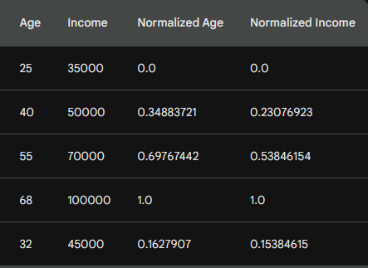
Min-Max Scaling for a Similar Example
How are they calculated?
Min-Max Scaled Age: We subtract the minimum age (25) from each age and then divide by the difference between the maximum and minimum ages (68 - 25). The result is a value between 0 and 1, where 0 represents the youngest person and 1 represents the oldest.
Min-Max Scaled Income: Similar to age, we subtract the minimum income ($35,000) from each income and then divide by the difference between the maximum and minimum incomes ($100,000 - $35,000). This again gives us a value between 0 and 1, where 0 represents the lowest income and 1 represents the highest.
Original and normalized values

Slide 7
Working with Non-Numeric Features – Encoding
When working with non-numeric data, we need to use encoding techniques, not scaling
One-Hot Encoding: Imagine each unique category in our data gets its own new column. In each column, only the corresponding category gets a 1, while all others remain 0. It's like turning on a single light switch for each category.
Label Encoding: This is the simplest approach. Each unique category gets assigned a unique integer. Think of it as numbering each color in a rainbow.
Frequency encoding: For each unique category in our data, calculate the percentage of observations in that category that have the desired target value. It will encode based on frequency: Replace each category with its calculated frequency. For example, if "City A" has a 60% purchase rate, all observations belonging to "City A" will get replaced with the value 0.6.

Slide 8
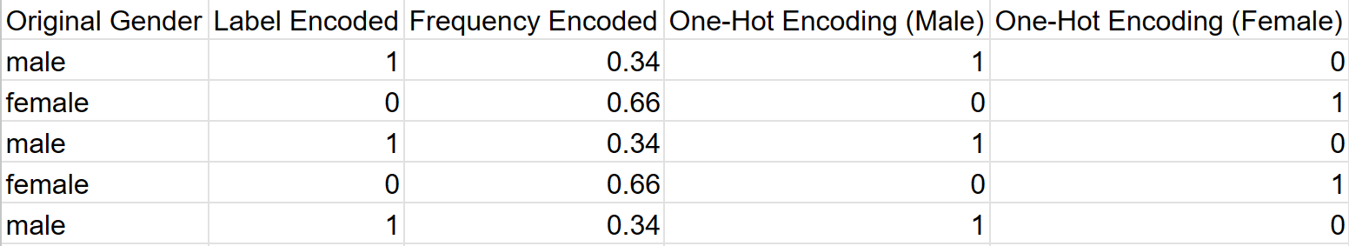
Example
Consider a category variable Gender that has 36% male records and 66% female records

